Slide 1
Image Management
- Vidyashree Rama(v00270735)

Slide 2
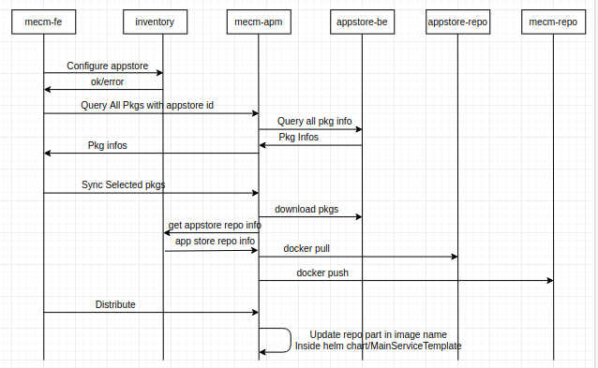
Flow Diagram

Slide 3
Method | API | RequestBody | Response
POST | Inventory/v1/appstores | AppStoreDto | ok/error
PUT | Inventory/v1/appstores/{appStoreID} | AppStoreDto | ok/error
GET | Inventory/v1/appstores | None | AppStoreDtos
GET | Inventory/v1/appstores/{appStoreID} | None | AppStoreDtos
DELETE | Inventory/v1/appstores/{appStoreID} | None | ok/error
DELETE | Inventory/v1/appstores | None | ok/error
GET | apm/v1/pkgInfos | AppStoreID | AppPkgInfos
POST | apm/v1/syncAppPkgs | AppPkgInfos | Ok/error

